Slide 1
Metagenomic Binning
Vijini Mallawaarachchi

Slide 2

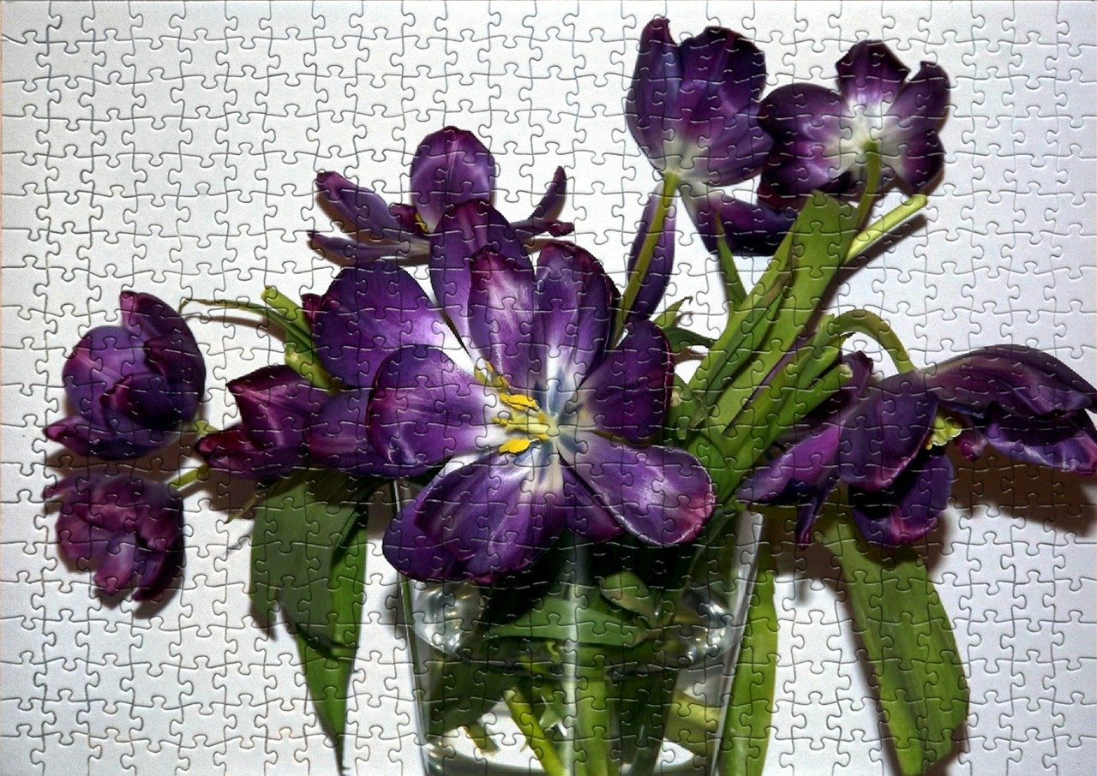
Jigsaw Puzzles
Solve the jigsaw puzzle
Images by Слава Вольгин from Pixabay and danuta niemiec from Pixabay

Slide 3
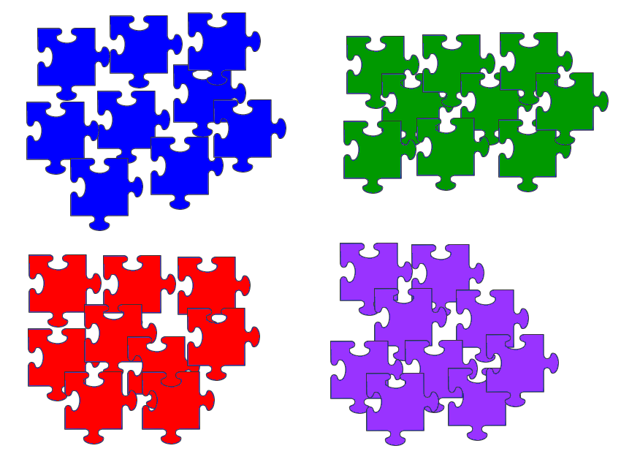
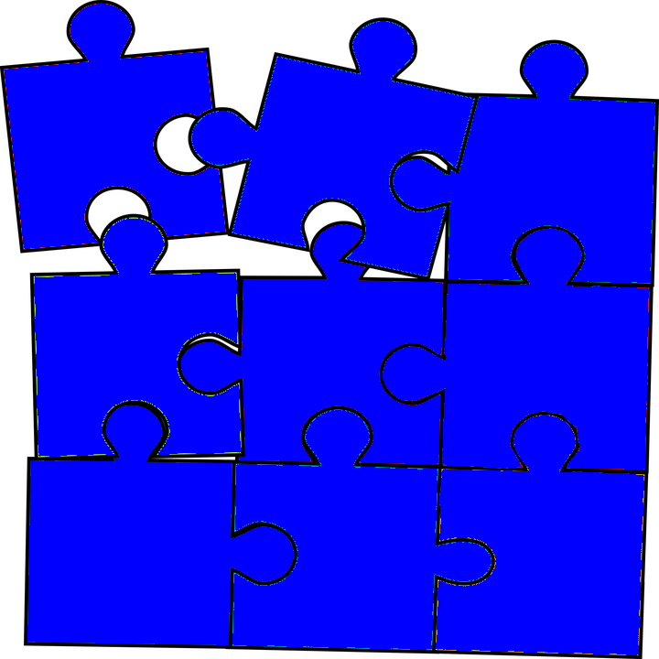
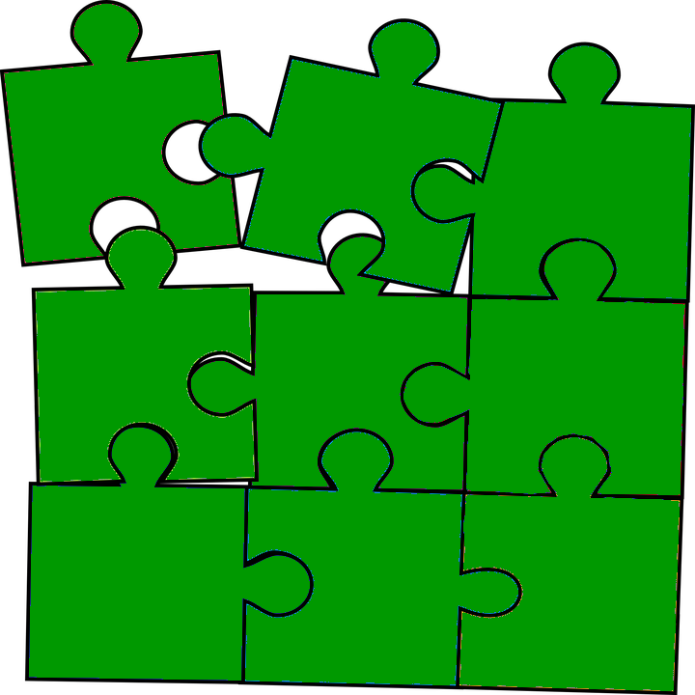
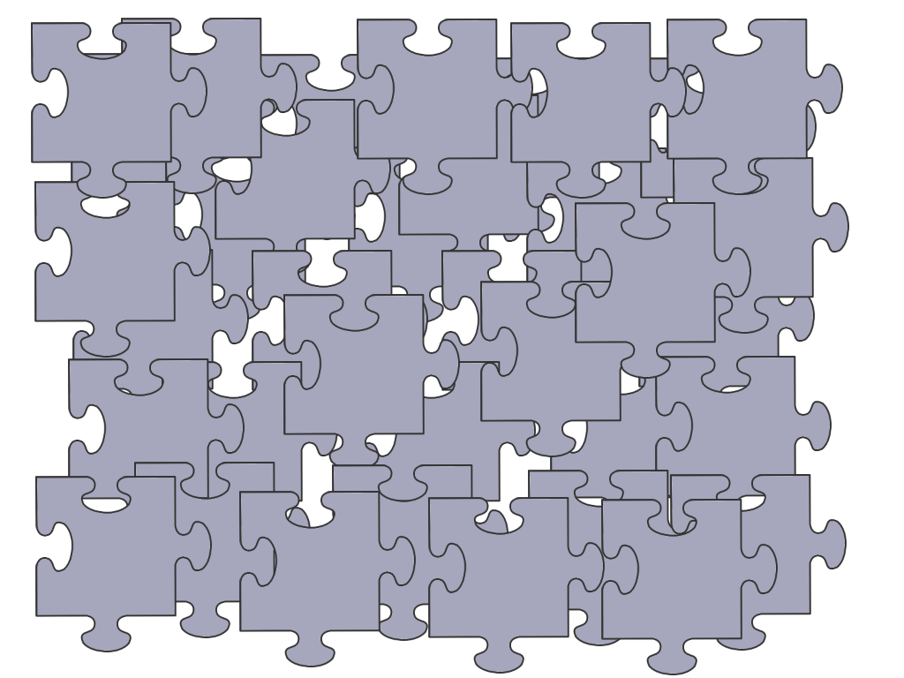

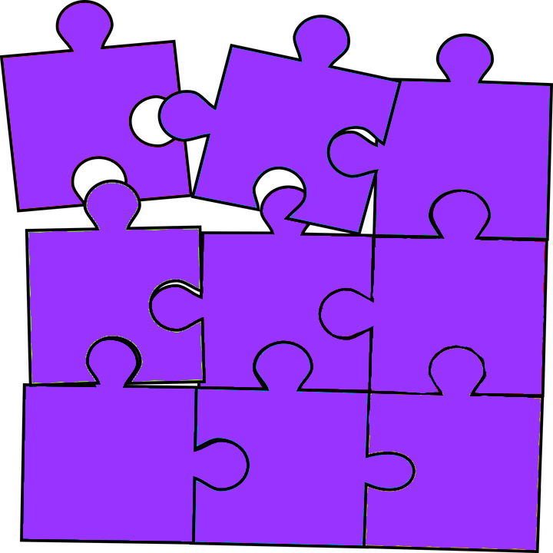
Mixed-up Jigsaw Puzzles
Separate puzzle pieces belonging to each puzzle
Solve each puzzle individually

Slide 4
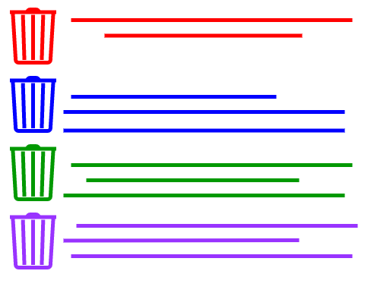
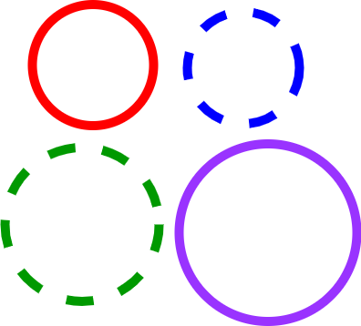

Metagenomic Binning
Metagenomic contigs
Binned metagenomic contigs
Partial/complete genomes
Metagenomics Binning
Separate metagenomic sequences into bins
Individually construct draft genomes

Slide 5
How do we separate contigs when we know almost nothing about the origins of our contigs at the end of assembly?
?
Metagenomic contigs
Partial/complete genomes

Slide 6
Two Main Features Used in Binning
Sequence Composition
Nucleotide composition
No prior understanding of the likely origins of contigs
Coverage
How many copies of each genome where there in the original sample?
Can get from sequencing data

Slide 7
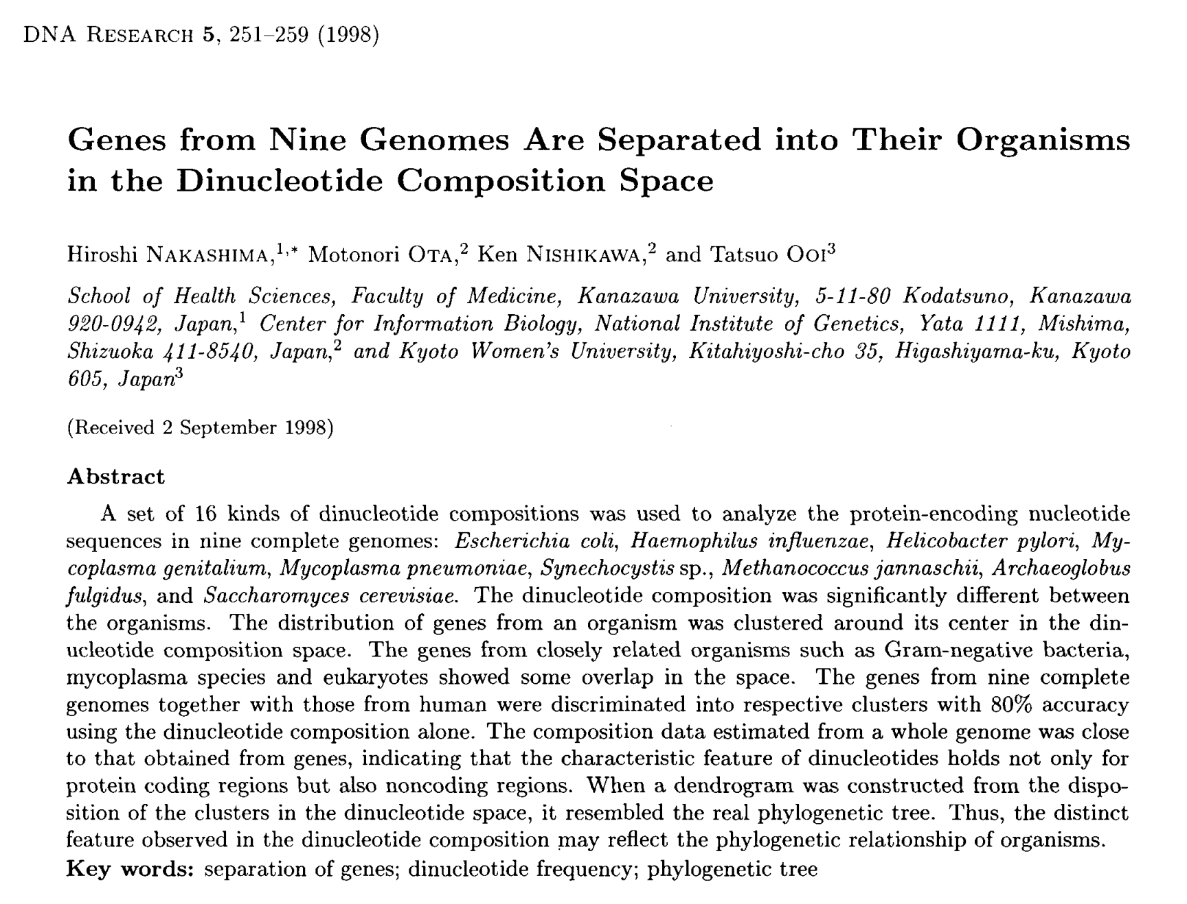
Sequence Composition
Consider oligonucleotide composition
Varies between species
Conserved within a species

Slide 8
Sequence Composition
How can we determine the oligonucleotide composition?
How can we represent the oligonucleotide composition so that computers can understand?
What do computers understand? Numbers!

Slide 9
Sequence Composition
Computer k-mer frequencies
A “k-mer” is a substring of length k
4 bases: {A, C, G, T}
4^{k} possible k-mers
k=2: 4² = 16
k=3: 4³ = 64
k=4: 4⁴ = 256
20 bp: 4²⁰ = 1,099,511,627,776
TAA
AAT
ATG
TGC
GCC
CCA
CAT
ATG
TGG
GGG
GGA
GAT
ATG
3-mer composition(TAATGCCATGGGATG)=
Adapted from Prof Rob Edward’s slides

Slide 10
Assume k=2
 | AA | AC | AG | AT | CA | CC | CG | CT | GA | GC | GG | GT | TA | TC | TG | TT
Seq1
Seq2
Seq3
Seq4
Adapted from https://www.slideshare.net/AMuratEren/intro-to-metagenomic-binning

Slide 11
Assume k=2
Seq1: GTTTTGGCATGATTAACCAGTTTCTTTTGTGCTTC
 | AA | AC | AG | AT | CA | CC | CG | CT | GA | GC | GG | GT | TA | TC | TG | TT
Seq1
Seq2
Seq3
Seq4
Adapted from https://www.slideshare.net/AMuratEren/intro-to-metagenomic-binning

Slide 12
Assume k=2
Seq1: GTTTTGGCATGATTAACCAGTTTCTTTTGTGCTTC
 | AA | AC | AG | AT | CA | CC | CG | CT | GA | GC | GG | GT | TA | TC | TG | TT
Seq1 |  |  |  |  |  |  |  |  |  |  |  | 1
Seq2
Seq3
Seq4
Adapted from https://www.slideshare.net/AMuratEren/intro-to-metagenomic-binning

Slide 13
Assume k=2
Seq1: GTTTTGGCATGATTAACCAGTTTCTTTTGTGCTTC
 | AA | AC | AG | AT | CA | CC | CG | CT | GA | GC | GG | GT | TA | TC | TG | TT
Seq1 |  |  |  |  |  |  |  |  |  |  |  | 1 |  |  |  | 1
Seq2
Seq3
Seq4
Adapted from https://www.slideshare.net/AMuratEren/intro-to-metagenomic-binning

Slide 14
Assume k=2
Seq1: GTTTTGGCATGATTAACCAGTTTCTTTTGTGCTTC
 | AA | AC | AG | AT | CA | CC | CG | CT | GA | GC | GG | GT | TA | TC | TG | TT
Seq1 |  |  |  |  |  |  |  |  |  |  |  | 1 |  |  |  | 2
Seq2
Seq3
Seq4
Adapted from https://www.slideshare.net/AMuratEren/intro-to-metagenomic-binning

Slide 15
Assume k=2
Seq1: GTTTTGGCATGATTAACCAGTTTCTTTTGTGCTTC
 | AA | AC | AG | AT | CA | CC | CG | CT | GA | GC | GG | GT | TA | TC | TG | TT
Seq1 |  |  |  |  |  |  |  |  |  |  |  | 1 |  |  |  | 3
Seq2
Seq3
Seq4
Adapted from https://www.slideshare.net/AMuratEren/intro-to-metagenomic-binning

Slide 16
Assume k=2
Seq1: GTTTTGGCATGATTAACCAGTTTCTTTTGTGCTTC
 | AA | AC | AG | AT | CA | CC | CG | CT | GA | GC | GG | GT | TA | TC | TG | TT
Seq1 |  |  |  |  |  |  |  |  |  |  |  | 1 |  |  | 1 | 3
Seq2
Seq3
Seq4
Adapted from https://www.slideshare.net/AMuratEren/intro-to-metagenomic-binning

Slide 17
Assume k=2
Seq1: GTTTTGGCATGATTAACCAGTTTCTTTTGTGCTTC
 | AA | AC | AG | AT | CA | CC | CG | CT | GA | GC | GG | GT | TA | TC | TG | TT
Seq1 |  |  |  |  |  |  |  |  |  |  | 1 | 1 |  |  | 1 | 3
Seq2
Seq3
Seq4
Adapted from https://www.slideshare.net/AMuratEren/intro-to-metagenomic-binning

Slide 18
Assume k=2
Seq1: GTTTTGGCATGATTAACCAGTTTCTTTTGTGCTTC
 | AA | AC | AG | AT | CA | CC | CG | CT | GA | GC | GG | GT | TA | TC | TG | TT
Seq1 | 1 | 1 | 1 | 3 | 2 | 1 | 0 | 2 | 2 | 2 | 1 | 3 | 1 | 2 | 4 | 10
Seq2
Seq3
Seq4
Adapted from https://www.slideshare.net/AMuratEren/intro-to-metagenomic-binning

Slide 19
Assume k=2
Seq2: ACGAATCTGCTTTTTGTCAGTAATCAACTTCTTTC
 | AA | AC | AG | AT | CA | CC | CG | CT | GA | GC | GG | GT | TA | TC | TG | TT
Seq1 | 1 | 1 | 1 | 3 | 2 | 1 | 0 | 2 | 2 | 2 | 1 | 3 | 1 | 2 | 4 | 10
Seq2 | 3 | 2 | 1 | 2 | 2 | 0 | 1 | 4 | 1 | 1 | 0 | 2 | 1 | 5 | 2 | 7
Seq3
Seq4
Adapted from https://www.slideshare.net/AMuratEren/intro-to-metagenomic-binning

Slide 20
Assume k=2
 | AA | AC | AG | AT | CA | CC | CG | CT | GA | GC | GG | GT | TA | TC | TG | TT
Seq1 | 1 | 1 | 1 | 3 | 2 | 1 | 0 | 2 | 2 | 2 | 1 | 3 | 1 | 2 | 4 | 10
Seq2 | 3 | 2 | 1 | 2 | 2 | 0 | 1 | 4 | 1 | 1 | 0 | 2 | 1 | 5 | 2 | 7
Seq3 | 1 | 2 | 0 | 0 | 2 | 3 | 1 | 2 | 9 | 9 | 2 | 5 | 0 | 0 | 4 | 4
Seq4 | 1 | 2 | 0 | 0 | 2 | 3 | 1 | 2 | 9 | 9 | 2 | 5 | 0 | 1 | 3 | 4
Adapted from https://www.slideshare.net/AMuratEren/intro-to-metagenomic-binning

Slide 21
Assume k=2
Organise the sequences based on the compositional similarity
 | AA | AC | AG | AT | CA | CC | CG | CT | GA | GC | GG | GT | TA | TC | TG | TT
Seq1 | 1 | 1 | 1 | 3 | 2 | 1 | 0 | 2 | 2 | 2 | 1 | 3 | 1 | 2 | 4 | 10
Seq2 | 3 | 2 | 1 | 2 | 2 | 0 | 1 | 4 | 1 | 1 | 0 | 2 | 1 | 5 | 2 | 7
Seq3 | 1 | 2 | 0 | 0 | 2 | 3 | 1 | 2 | 9 | 9 | 2 | 5 | 0 | 0 | 4 | 4
Seq4 | 1 | 2 | 0 | 0 | 2 | 3 | 1 | 2 | 9 | 9 | 2 | 5 | 0 | 1 | 3 | 4
Adapted from https://www.slideshare.net/AMuratEren/intro-to-metagenomic-binning

Slide 22
Assume k=2
Organise the sequences based on the compositional similarity
 | AA | AC | AG | AT | CA | CC | CG | CT | GA | GC | GG | GT | TA | TC | TG | TT
Seq1 | 1 | 1 | 1 | 3 | 2 | 1 | 0 | 2 | 2 | 2 | 1 | 3 | 1 | 2 | 4 | 10
Seq2 | 3 | 2 | 1 | 2 | 2 | 0 | 1 | 4 | 1 | 1 | 0 | 2 | 1 | 5 | 2 | 7
Seq3 | 1 | 2 | 0 | 0 | 2 | 3 | 1 | 2 | 9 | 9 | 2 | 5 | 0 | 0 | 4 | 4
Seq4 | 1 | 2 | 0 | 0 | 2 | 3 | 1 | 2 | 9 | 9 | 2 | 5 | 0 | 1 | 3 | 4
Seq1
Seq3
Seq2
Seq4
Seq1
Seq2
Seq3
Seq4
Adapted from https://www.slideshare.net/AMuratEren/intro-to-metagenomic-binning

Slide 23
When contig lengths are different
Normalise the k-mer counts → Normalised k-mer frequencies
Total number of k-mers in a contig of length l = l-k+1
Divide each count by the total count of k-mers of the sequence
 | AA | AC | AG | AT | CA | CC | CG | CT | GA | GC | GG | GT | TA | TC | TG | TT
Seq1 | 1/34 | 1/34 | 1/34 | 3/34 | 2/34 | 1/34 | 0/34 | 2/34 | 2/34 | 2/34 | 1/34 | 3/34 | 1/34 | 2/34 | 4/34 | 10/34
Seq2 | 3/34 | 2/34 | 1/34 | 2/34 | 2/34 | 0/34 | 1/34 | 4/34 | 1/34 | 1/34 | 0/34 | 2/34 | 1/34 | 5/34 | 2/34 | 7/34
Seq3 | 1/34 | 2/34 | 0/34 | 0/34 | 2/34 | 3/34 | 1/34 | 2/34 | 9/34 | 9/34 | 2/34 | 5/34 | 0/34 | 0/34 | 4/34 | 4/34
Seq4 | 1/34 | 2/34 | 0/34 | 0/34 | 2/34 | 3/34 | 1/34 | 2/34 | 9/34 | 9/34 | 2/34 | 5/34 | 0/34 | 1/34 | 3/34 | 4/34

Slide 24
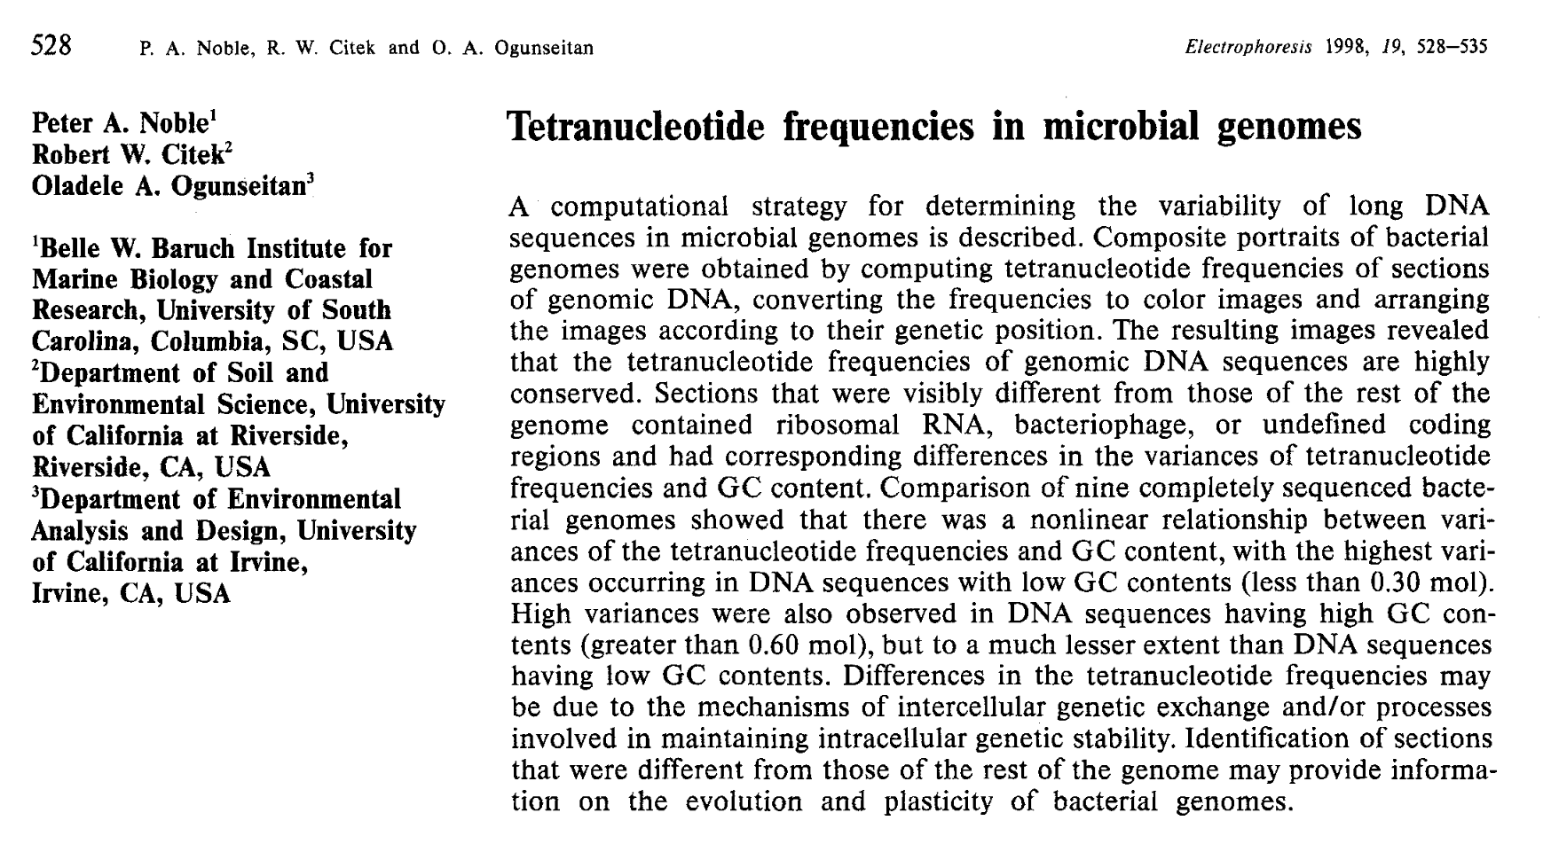
Assume k=4
Tetranucleotide frequency
Most commonly used k value

Slide 25
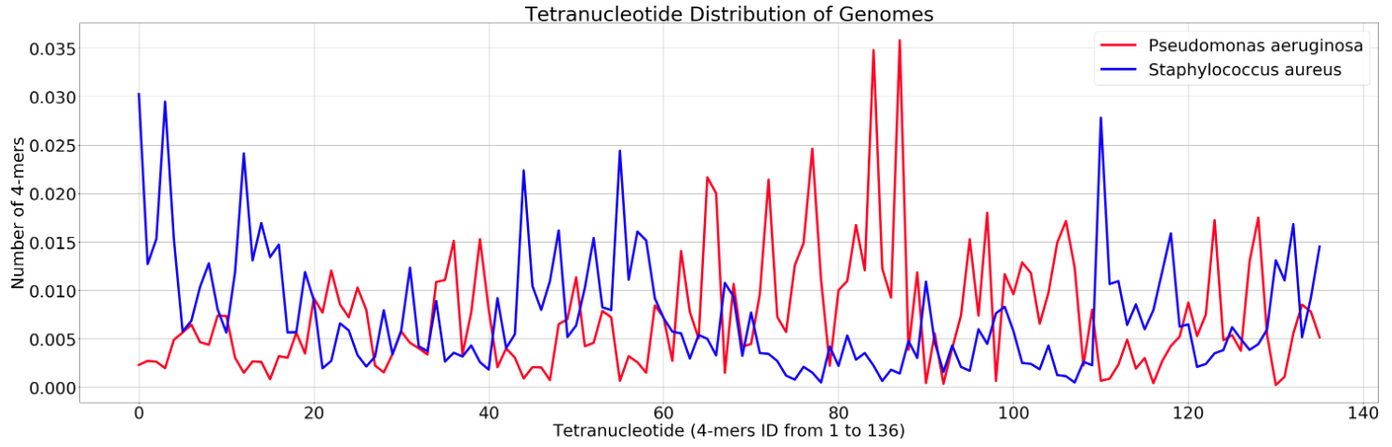
Composition alone is not enough
Assumption: Sequence composition varies between species

Slide 26
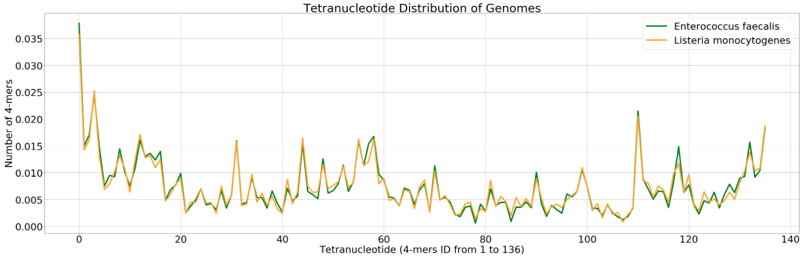
Composition alone is not enough
Assumption: Sequence composition varies between species
This is not always true!

Slide 27
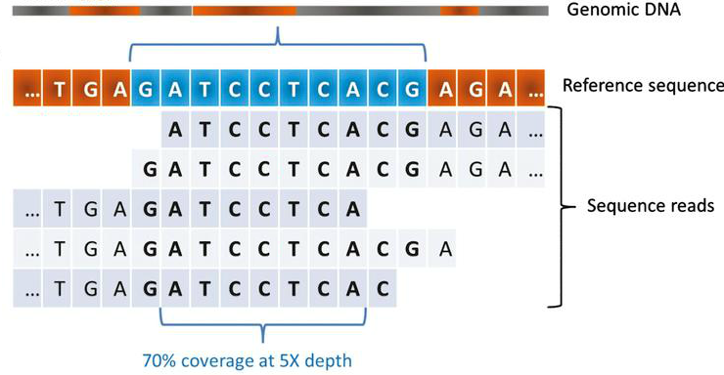
Coverage
Coverage is the average number of reads covering each nucleotide position of a contig
Genomic DNA
Contig
Coverage
The average number of reads that covers each base of a contig
Reads
5X coverage
Adapted from: https://content.iospress.com/articles/journal-of-neuromuscular-diseases/jnd150092

Slide 28
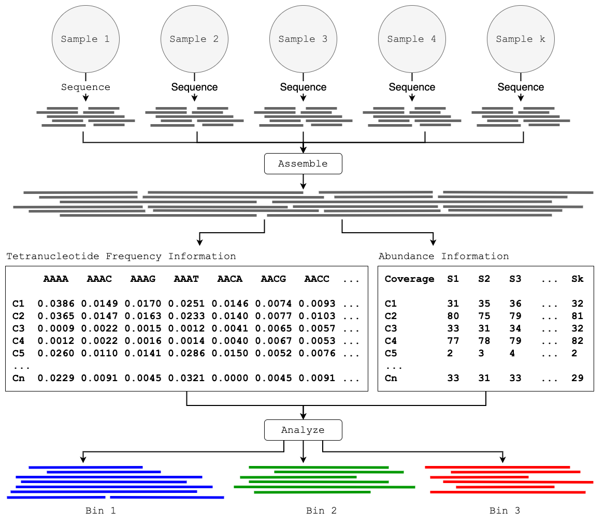
Differential Coverage
Consider the variation of coverage of contigs across samples
 | A | B | C | D | E | F
S1 | 8 | 2 | 3 | 8 | 3 | 2
S2 | 1 | 5 | 3 | 1 | 3 | 5
S3 | 1 | 2 | 8 | 1 | 8 | 2
Map reads in each sample and get coverage of contigs
A
B
C
D
E
F
C
Contigs
E
A
B
D
F
Adapted from https://www.slideshare.net/AMuratEren/intro-to-metagenomic-binning

Slide 29
Hybrid Binning
Consider both sequence composition and coverage
Popular tools
CONCOCT
MaxBin
MetaBAT
VAMB

Slide 30
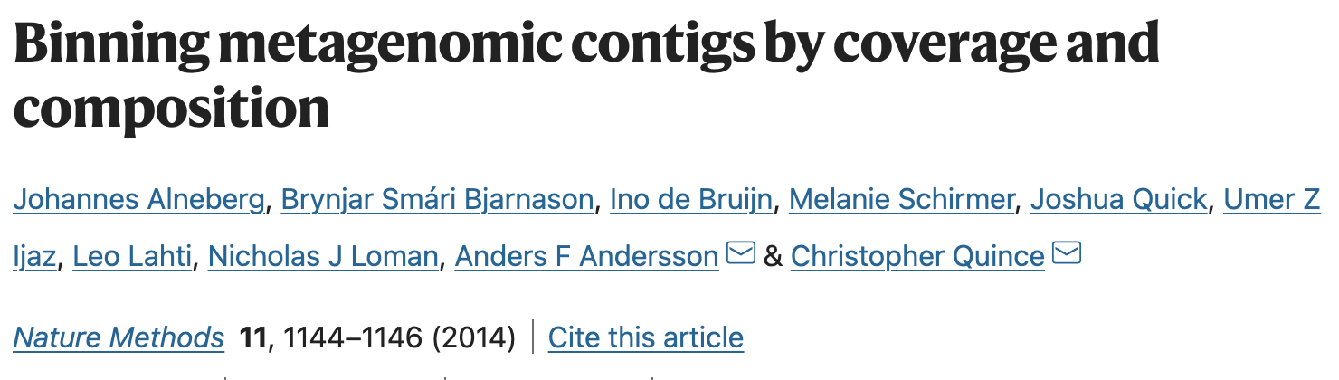
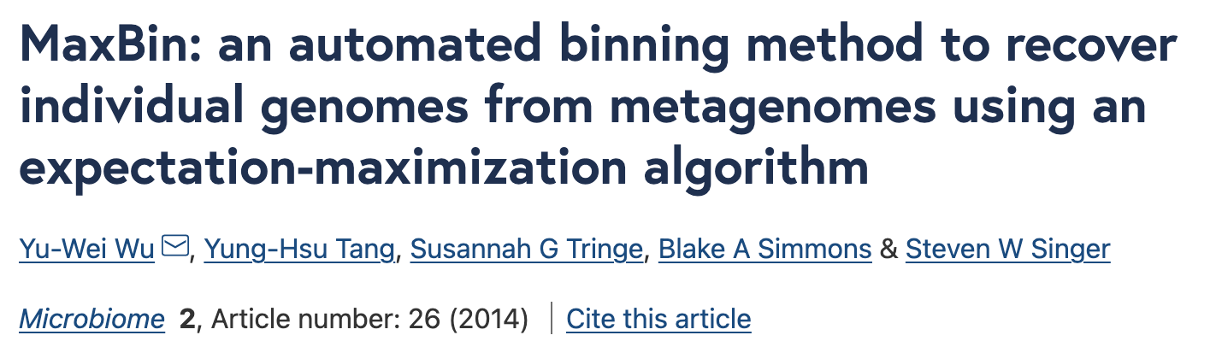
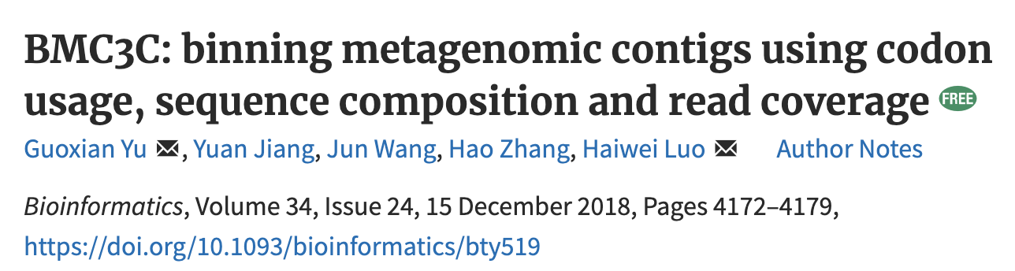
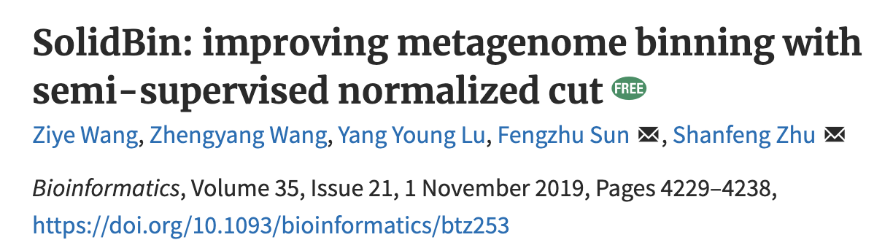

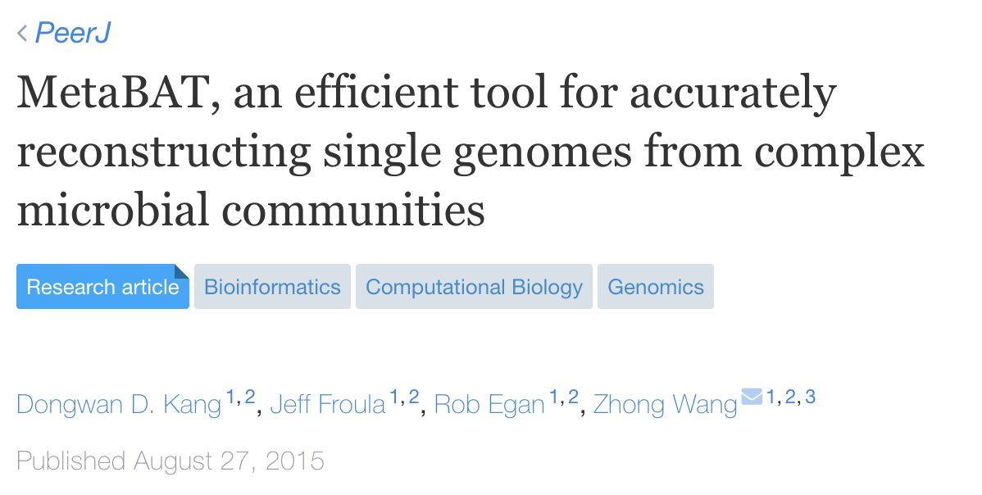
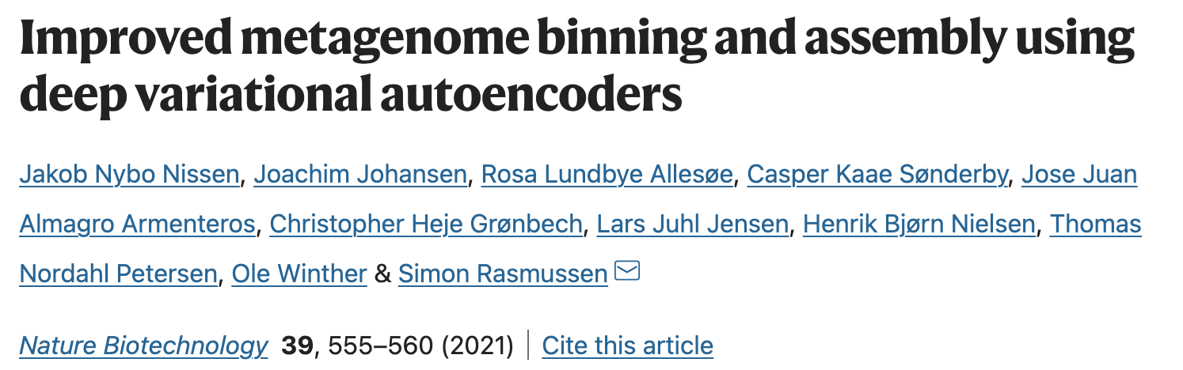

Many Automated Binning Tools

Slide 31
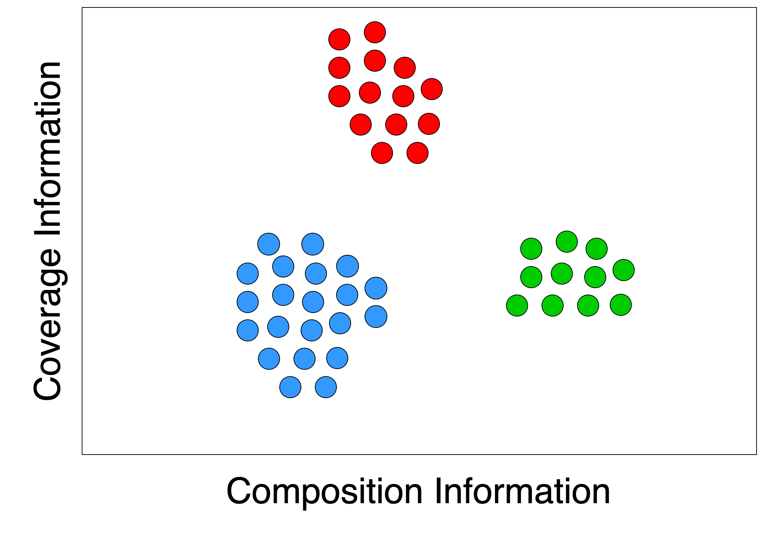
Problems in Binning
Long contigs
(> 1000 bp)
MaxBin2
CONCOCT
MetaBAT2
SolidBin
Vamb
Many more…

Slide 32
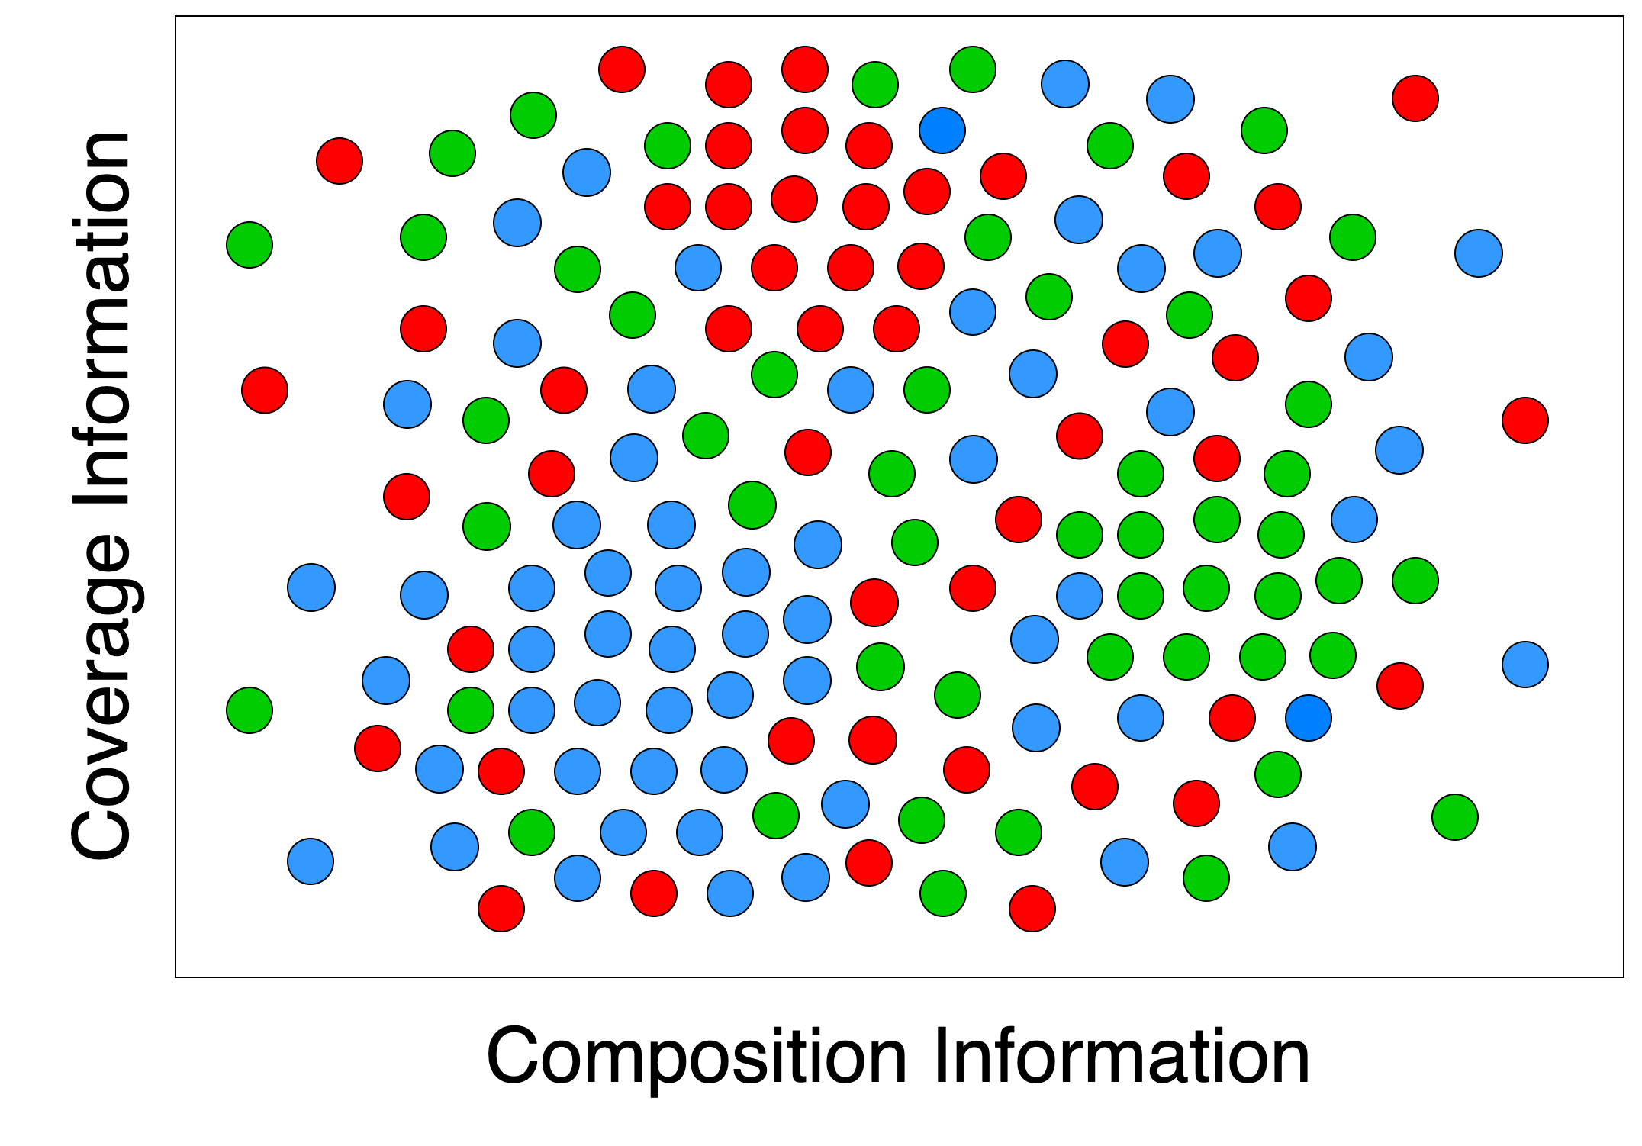
Problems in Binning
All contigs

Slide 33
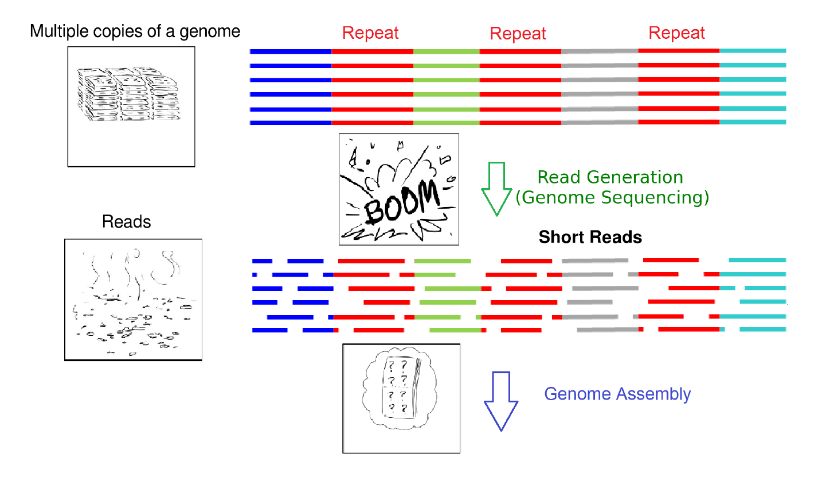
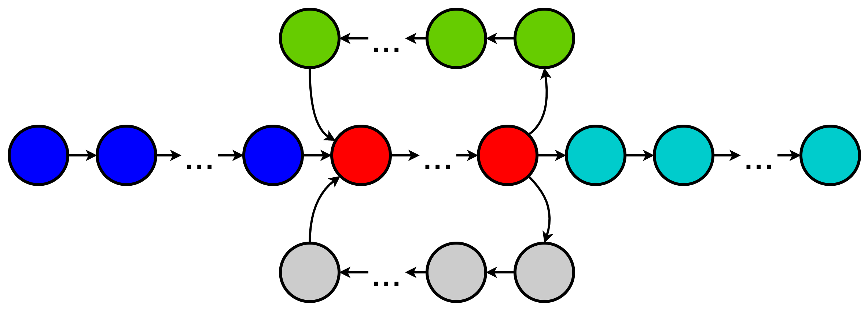
Recall how we get contigs
Repeat Repeat Repeat
Multiple copies
of a genome
Read Generation
(Genome Sequencing)
Short
Reads
Genome Assembly
Assembly Graph with Contigs

Slide 34
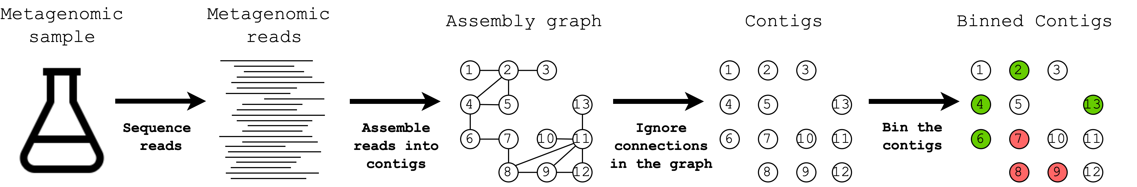
Current Binning Approaches
Remember that contigs are assembled using the assembly graph.
Connection information between contigs is valuable for binning.

Slide 35
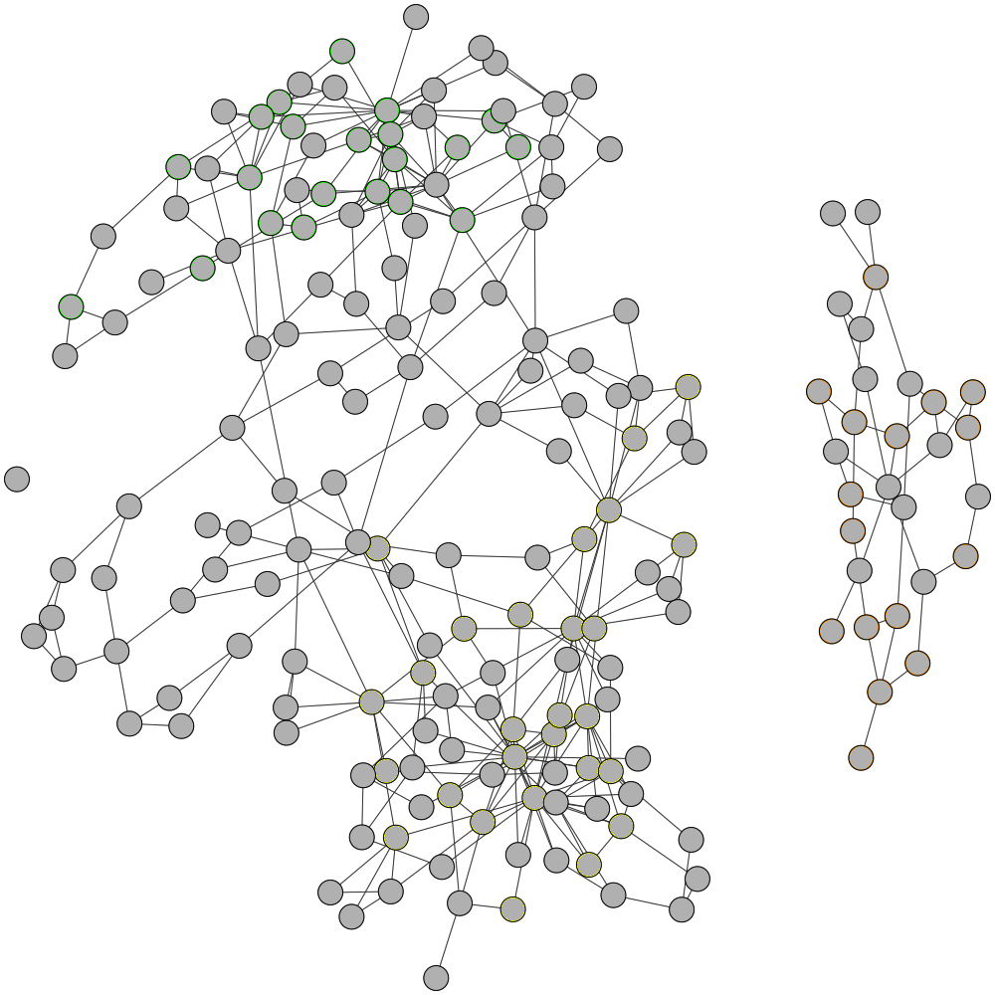
Assembly Graph
Visualisation of the assembly graph with 3 species
Adapted from https://github.com/metagentools/GraphBin

Slide 36
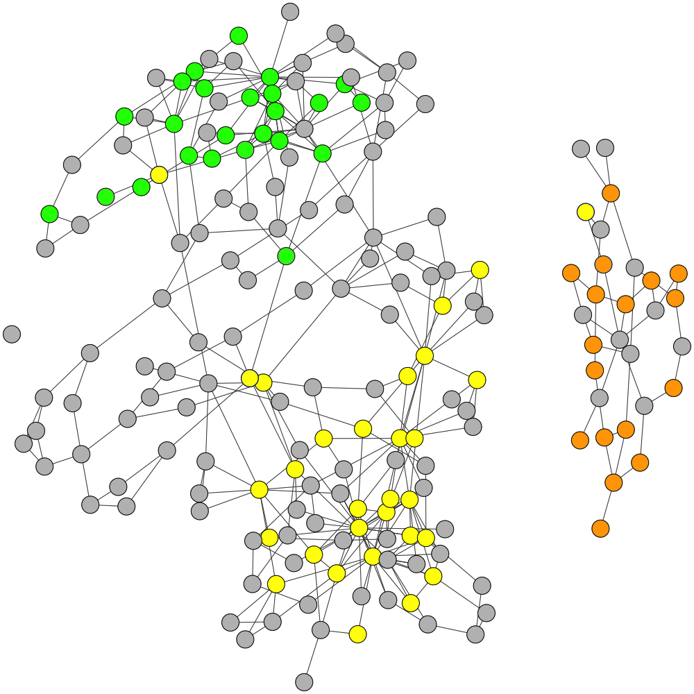
Assembly Graph
Initial labelling from a contig-binning tools
Adapted from https://github.com/metagentools/GraphBin

Slide 37
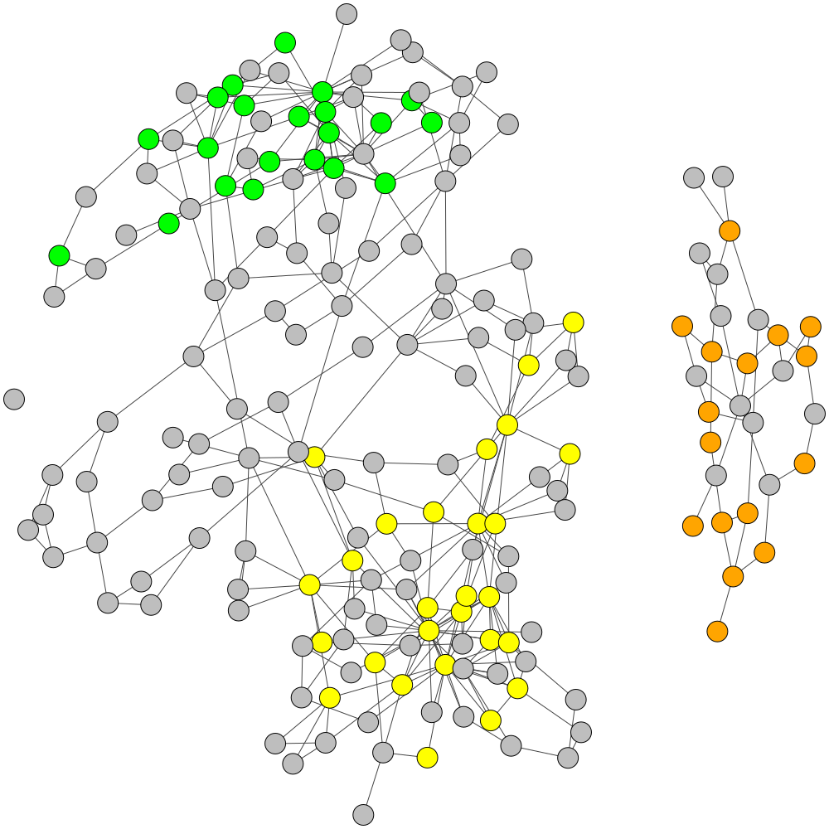
Assembly Graph
Refine labels
Adapted from https://github.com/metagentools/GraphBin

Slide 38
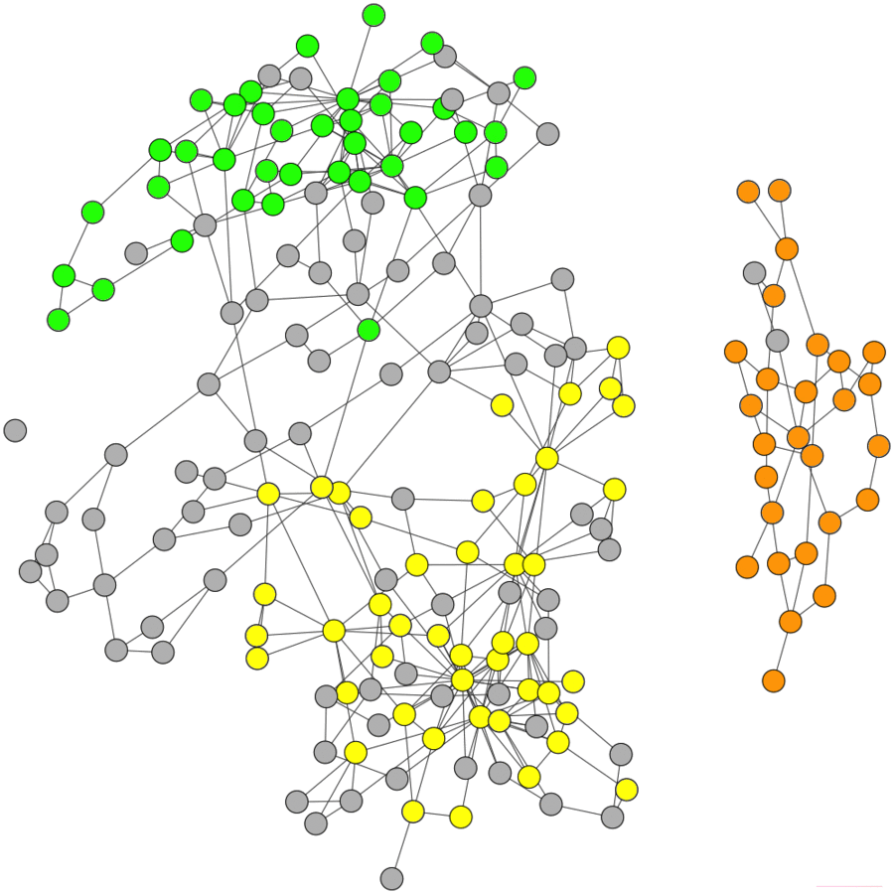

Assembly Graph
Perform label propagation and refinement
Adapted from https://github.com/metagentools/GraphBin

Slide 39
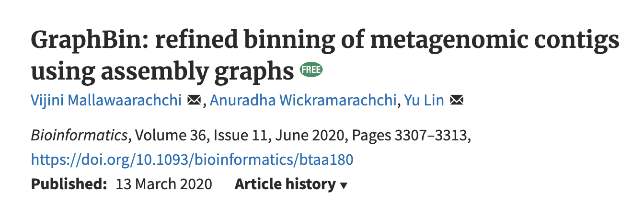
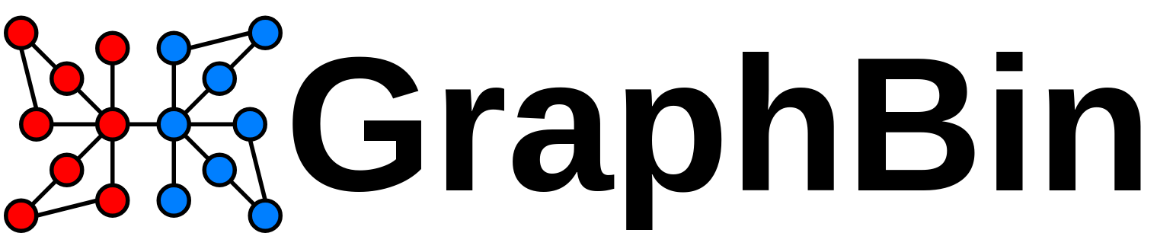
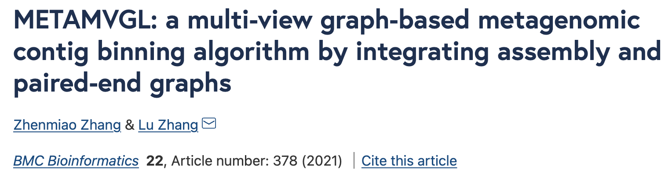
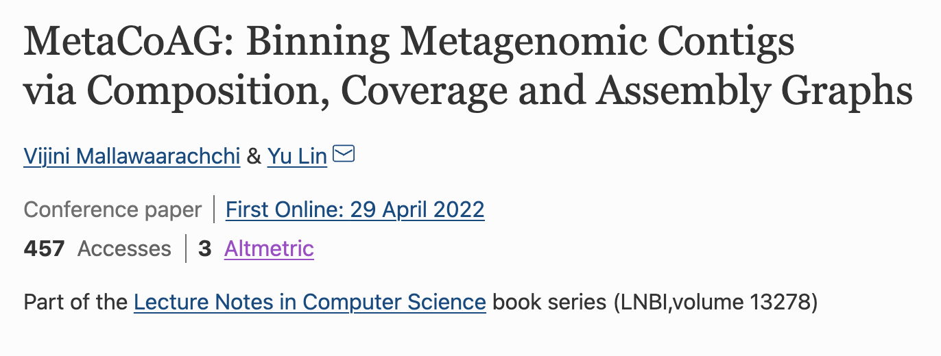
Assembly Graphs in Metagenomic Binning

Slide 40
Think twice before you trust a bin you get from any binning tool!
Notes:
Metagenomic data is complex and things will often work less than optimal.
However, there are ways to help you decide whether you can trust a bin or not.

Slide 41
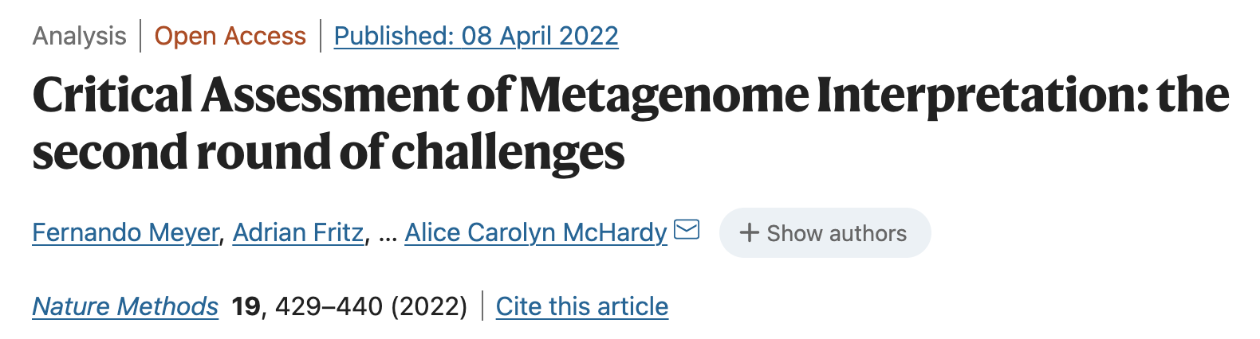
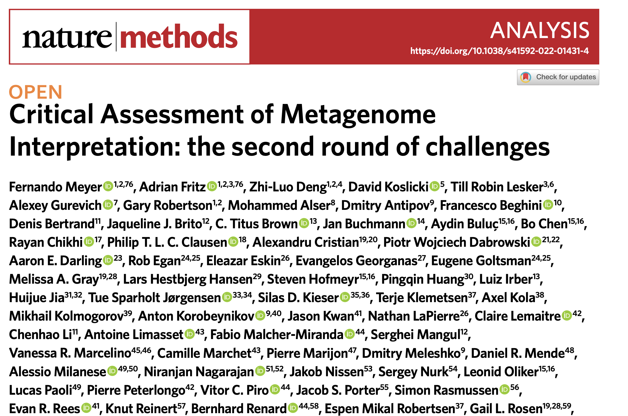
See public benchmark studies

Slide 42

Evaluating Bins
AMBER: Assessment of Metagenome BinnERs
Only if you know the underlying species in your sample
Precision, Recall, F1-score, etc.
CheckM
Estimates genome completeness and contamination by using single-copy marker genes

Slide 43
Binning hands-on
Let’s run MetaBAT2 and refine bins using GraphBin
https://bioinf.cc/workshop2022/metagenomic-binning

Slide 44
MetaBAT2
Run MetaBAT2
metabat2 -i contigs.fasta -a depth.txt -o metabat_bins/bin

Slide 45
GraphBin
Preprare results
python prep_result.py --binned metabat_bins --output ./
Run GraphBin
graphbin --assembler spades --graph assembly_graph_with_scaffolds.gfa --contigs contigs.fasta --paths contigs.paths --binned initial_contig_bins.csv --output ./

